Slide 1
Open Banking Using Spring Boot
PR 301 Course Project
Dhriti Agarwal – SE20UCSE041
Krish Hindocha – SE20UCSE072
Neha Sharma – SE20UCAM026
[February 2023- June 2023]

Slide 2
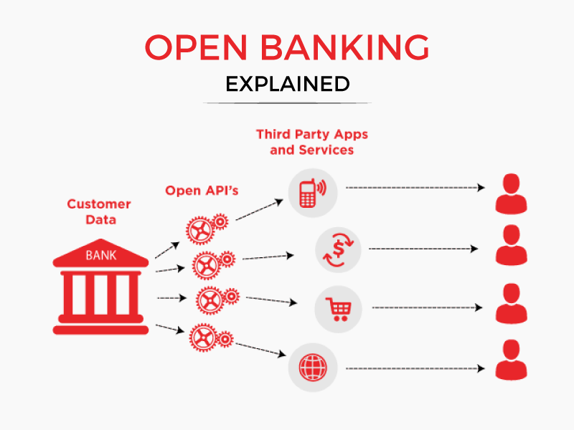
What is Open Banking?
These are third party apps like Paytm, GooglePay.etc which offer banking services and non banking services to consumers. Data of the consumers will not be given or shared to anyone else without their consent.
In traditional banking, data related to the transaction and credit history of any customer is available to the parent banks only, whereas, in open banking, data is exposed, in a secure manner, to third party partners (TPPs) through public application program interfaces. In addition, these TPPs provide specialized services also.

Slide 3
Introduction
Open Banking has revolutionized finance by allowing secure access to financial data. In this project, we'll use Spring Boot, a Java framework, to implement Open Banking.
The objective of this project is to demonstrate how to implement Open Banking using Spring Boot.
- Understand the concept of Open Banking and its importance in the financial industry.
- Develop a secure and compliant Open Banking platform using Spring Boot.
- Apply best practices and design patterns to build a scalable and maintainable Open Banking solution.
- Learn about Restful APIs and more about Springboot
This project offers a practical guide for financial institutions to implement secure and compliant Open Banking using Spring Boot.

Slide 4
Approach we took
1. We read a white paper on Open Banking and understood about the concept we are trying to build.
2. Then, we learnt about Restful APIs and their operations.
3. Then, we learnt about Springboot and Java 1.8 version features as we were working on JAVA 1.8.
4. We then learnt about Swagger and Postman.
5. We tested few sample codes using Junit.
6. Then we looked at sample CRUD operation codes to know the working of these operations.
7. At the end, our project was executed using build tool – MAVEN.

Slide 5
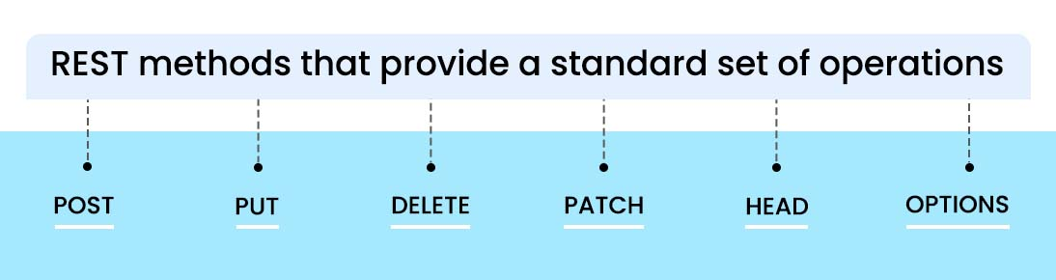
Restful APIs and their operations
A REST API (also known as RESTful API) is an application programming interface (API or web API) that conforms to the constraints of REST architectural style and allows for interaction with RESTful web services. REST stands for representational state transfer and was created by computer scientist Roy Fielding.

Slide 6
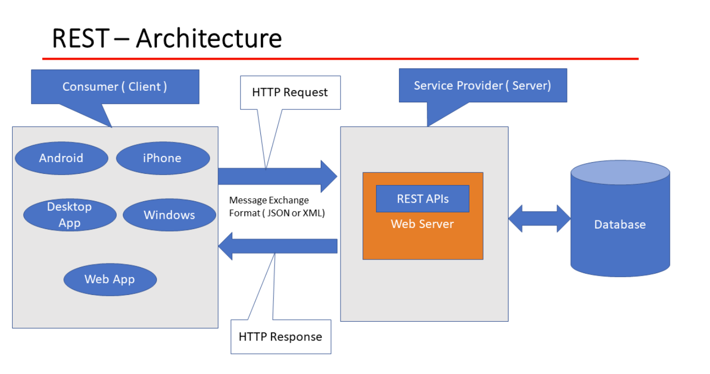

Slide 7
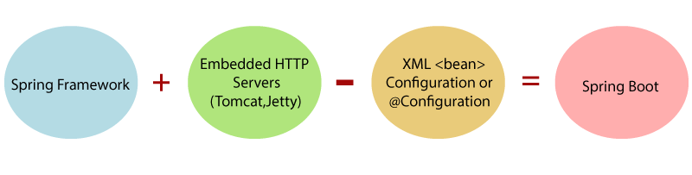
Springboot Framework
Java Spring Boot is a framework that simplifies the development of Java-based web applications and microservices. By using the capabilities of the Spring framework, it offers a quicker method for developing reliable and scalable applications.
Advantages
Works well with several servlet containers
No XML Configuration required
POM dependency management
Disadvantages
Large deployment files
Inability to build large and monolithic applications
Features
Building REST API Services
YAML Support
Security

Slide 8

About Java 1.8
Lambda expressions,
Method references,
Functional interfaces,
Stream API,
Default methods,
Base64 Encode Decode,
Static methods in interface,
Optional class,
Collectors class,
ForEach() method,
Nashorn JavaScript Engine,
Parallel Array Sorting,
Type and Repeating Annotations,
IO Enhancements,
Concurrency Enhancements,
JDBC Enhancements etc.

Slide 9
Swagger and Postman
Swagger
An open-source framework for designing, building, documenting, and consuming RESTful web services. It includes tools for defining APIs, such as the OpenAPI Specification, and provides interactive API documentation through Swagger UI.
Postman
A collaboration platform for API development and testing. It offers features for designing and testing APIs, sending various types of HTTP requests, handling authentication, and inspecting responses. It also supports automation, response validation, and team collaboration through shared collections.

Slide 10
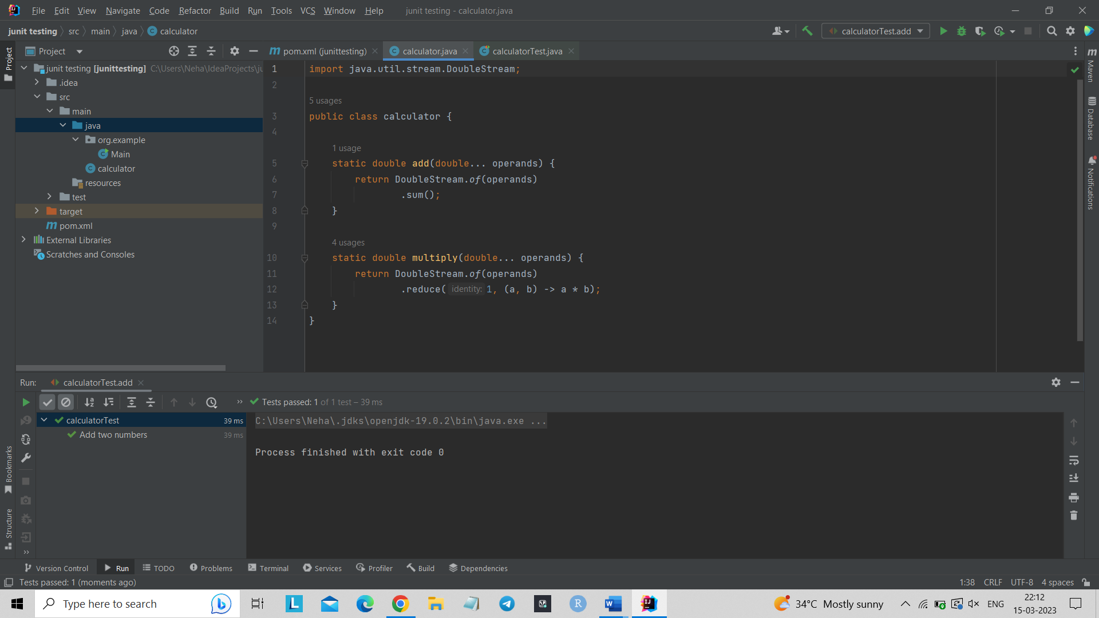
J-Unit Testing
Provides basic and advanced concepts of unit testing in java with examples.
There are two ways to perform unit testing:
manual testing
automated testing.
@Test
@Test(timeout=1000)
@BeforeClass
@Before
@After
@AfterClass

Slide 11
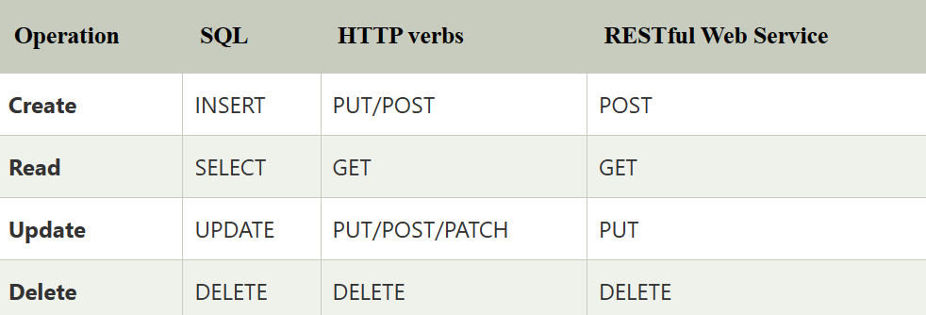
CRUD Operations
Spring Boot CRUD Repository:
Interface of Spring Boot called CrudRepository, it contains methods for CRUD operations. Its defined in the package org.springframework.data.repository. Extends the interface Repository. If we want to use this interface, we have to create and interface and extend this interface.

Slide 12
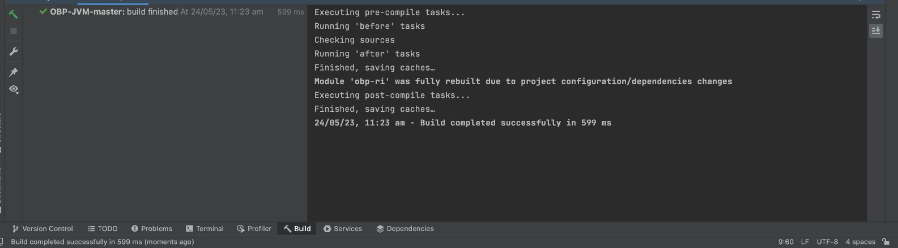
Final Project Implementation
https://github.com/OpenBankProject/OBP-JVM
We referred to the code from this link and then ran the code on IntelliJ Idea and builded it using Maven.

Slide 13


